Slide 1
Motivation/context
Overview including human relation
???
Inverse perspective mapping (Camera lens distortion correction)
Road surface detection
Probabilistic histogram
Local orientation
Hough
Feature matching
Probabilistic Model matching
Optical flow
Confirmed by model matching
Path curve matching
Bezier curve path modelling

Slide 2
Put in a fun little bit here

Slide 3
Original scope
Intersection detection from still image
Restrictions
No other vehicles
Detectable road surface
Extension
Driving line confirmation and intersection tracking

Slide 4
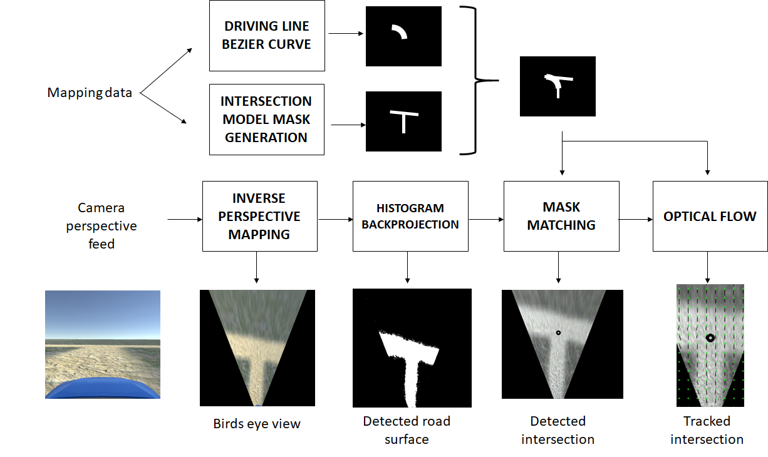

Slide 7
IPM
3 part : Left image with points, points mapped to RHS, All pixels mapped
IPM mask
Pixel to real world distance

Slide 10
Histogram Backprojection
IPM with box

Slide 13
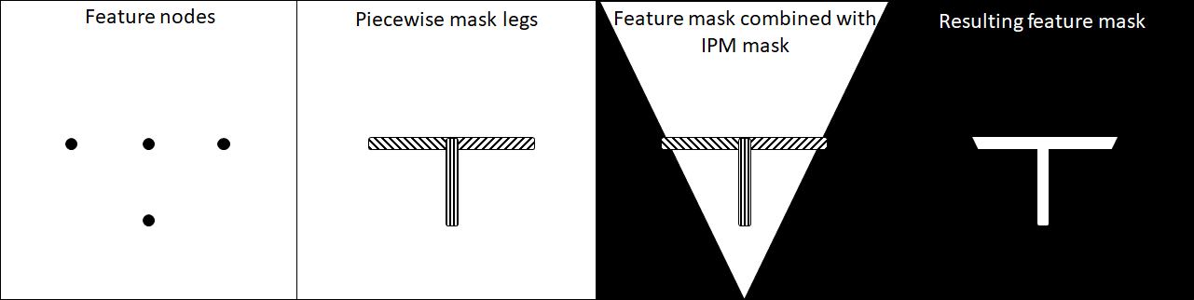
Feature mask generation

Slide 16
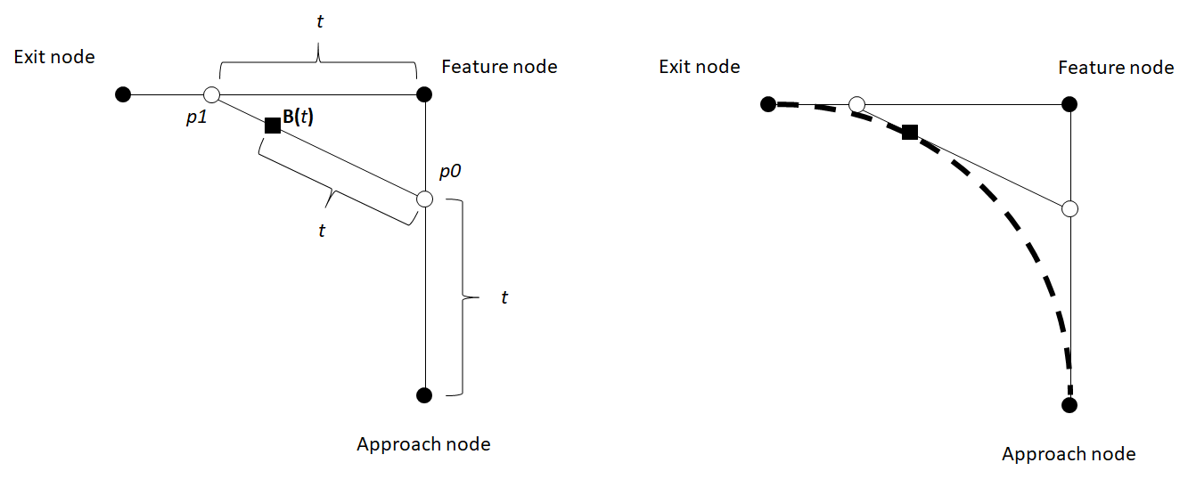
Driving line generation

Slide 20
Mask Matching
Find a wy to articulate this quickly

Slide 23
Optical flow
Single pixel eg
IPM Box eg

Slide 24
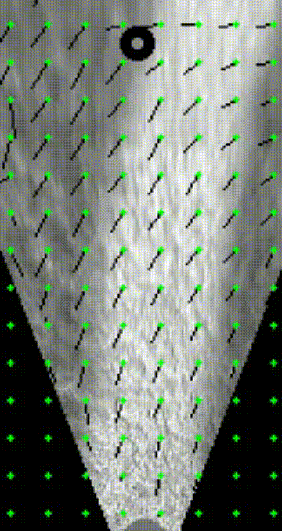
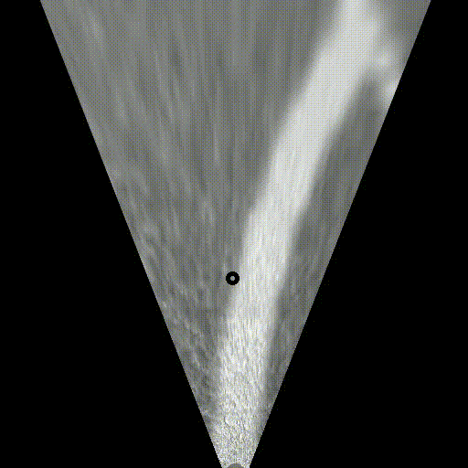
Optical flow

Slide 26
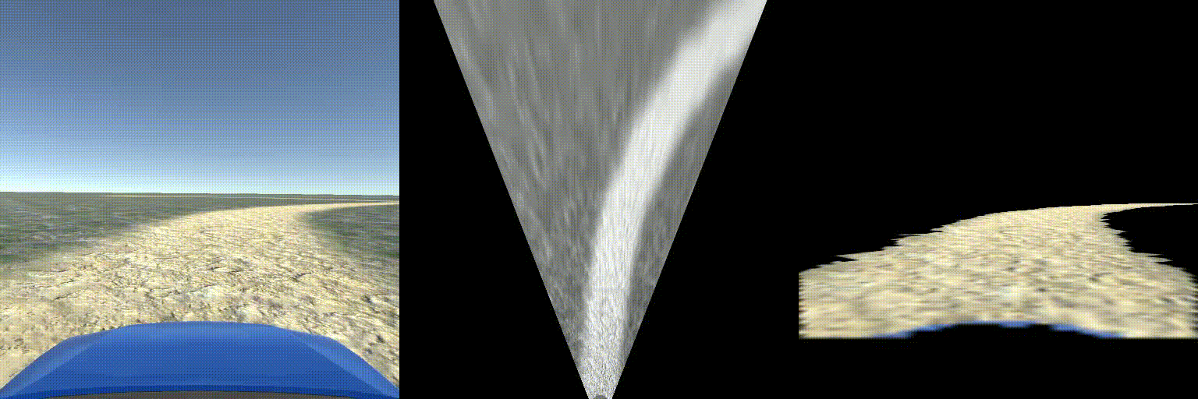

Slide 27
QUESTIONS

Slide 28
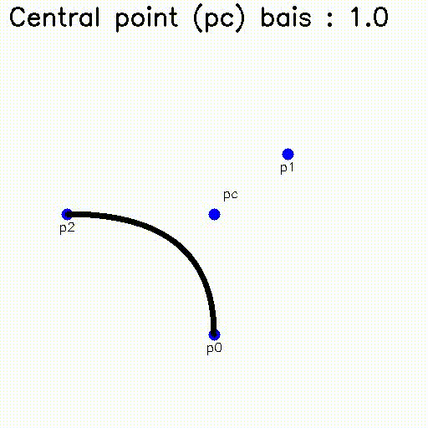
Path matching
Bezier curve theory
Interpolation between central point as p1 vs pc

Slide 29
Optical flow
Two-Frame Motion Estimation Based on Polynomial Expansion
Gunnar Farnebäck
http://www.diva-portal.org/smash/get/diva2:273847/FULLTEXT01.pdf

Slide 30
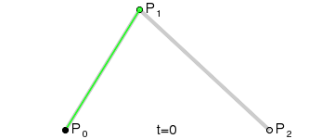
Bezier Curves

